Slide 1
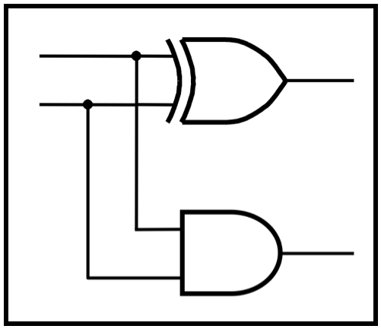
CprE 281:
Digital Logic
Instructor: Alexander Stoytchev
http://www.ece.iastate.edu/~alexs/classes/

Slide 2
Code Converters
CprE 281: Digital Logic
Iowa State University, Ames, IA
Copyright © Alexander Stoytchev

Slide 3
Administrative Stuff
HW 7 is out
It is due next Monday (Oct 17) @ 4pm

Slide 4
Administrative Stuff
The second midterm is in 2 weeks.

Slide 5
Administrative Stuff
Midterm Exam #2
When: Friday October 28 @ 4pm.
Where: This classroom
What: Chapters 1, 2, 3, 4 and 5.1-5.8
The exam will be open book and open notes (you can bring up to 3 pages of handwritten/typed notes).

Slide 6
Midterm 2: Format
The exam will be out of 130 points
You need 95 points to get an A
It will be great if you can score more than 100 points.
  but you can’t roll over your extra points ☹

Slide 7
Quick Review

Slide 8
Decoders

Slide 9
2-to-4 Decoder (Definition)
Has two inputs: w₁ and w₀
Has four outputs: y₀ , y_{1 ,} y₂ , and y₃
If w₁=0 and w₀=0, then the output y₀ is set to 1
If w₁=0 and w₀=1, then the output y₁ is set to 1
If w₁=1 and w₀=0, then the output y₂ is set to 1
If w₁=1 and w₀=1, then the output y₃ is set to 1
Only one output is set to 1. All others are set to 0.

Slide 10
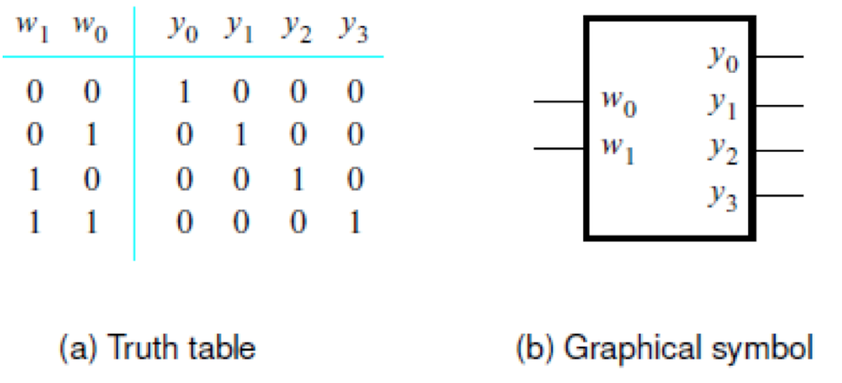
Truth Table and Graphical Symbol for a 2-to-4 Decoder
[ Figure 4.13a-b from the textbook ]

Slide 11
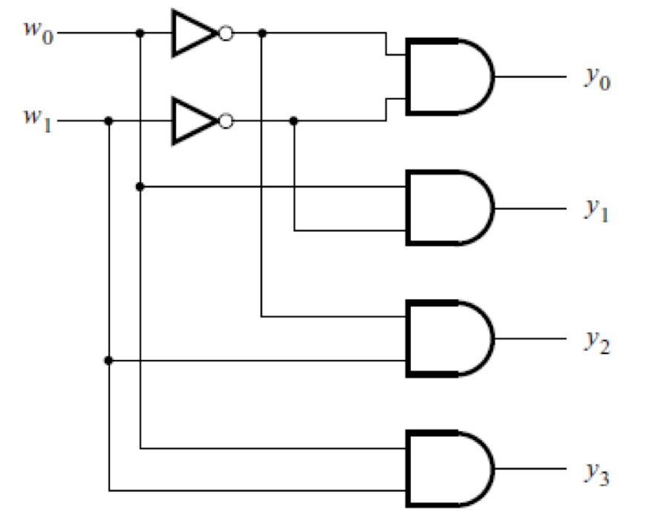
Truth Logic Circuit for a 2-to-4 Decoder
[ Figure 4.13c from the textbook ]

Slide 12
Adding an Enable Input
En
[ Figure 4.13c from the textbook ]

Slide 13
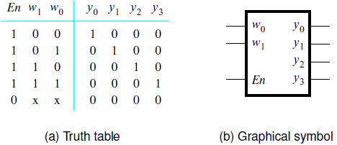
Truth Table and Graphical Symbol for a 2-to-4 Decoder with an Enable Input
[ Figure 4.14a-b from the textbook ]

Slide 14
Truth Table and Graphical Symbol for a 2-to-4 Decoder with an Enable Input
x indicates that it does not matter
what the value of these variable is
for this row of the truth table
[ Figure 4.14a-b from the textbook ]

Slide 15
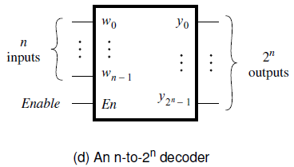
Graphical Symbol for a Binary n-to-2^{n} Decoder with an Enable Input
A binary decoder with n inputs has 2^{n} outputs
The outputs of an enabled binary decoder are “one-hot” encoded,
meaning that only a single bit is set to 1, i.e., it is hot.
[ Figure 4.14d from the textbook ]

Slide 16
A 3-to-8 decoder using two 2-to-4 decoders
w
w
y
y
0
0
0
0
w
w
y
y
1
1
1
1
y
y
2
w
2
2
En
y
y
3
3
En
w
y
y
4
0
0
w
y
y
5
1
1
y
y
6
2
En
y
y
7
3
[ Figure 4.15 from the textbook ]

Slide 17
A 4-to-16 decoder built using a decoder tree
w
w
y
y
0
0
0
0
w
w
y
y
1
1
1
1
y
y
2
2
En
y
y
3
3
w
y
y
0
0
4
w
y
y
1
1
5
y
y
w
2
6
2
w
y
En
y
y
0
0
3
7
w
w
y
3
1
1
y
2
y
w
y
y
En
En
w
8
3
0
0
w
y
y
1
1
9
y
y
2
10
En
y
y
3
11
w
y
y
0
0
12
w
y
y
1
1
13
y
y
2
14
En
y
y
[ Figure 4.16 from the textbook ]
3
15

Slide 18
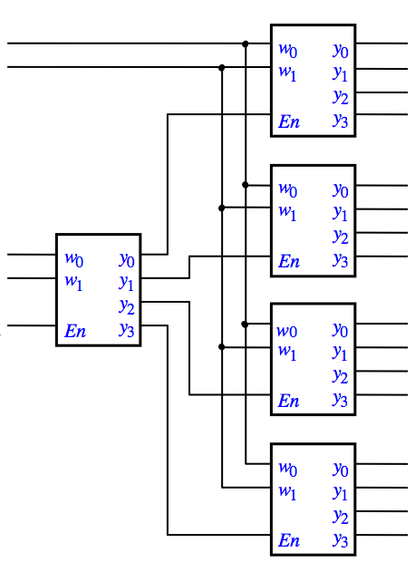
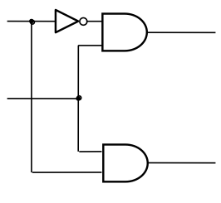
Let’s build a
5-to-32 decoder

Slide 19
Let’s build a
5-to-32 decoder
y₀ – y₁₅
En
y₁₆ – y₃₁

Slide 20
Let’s build a
5-to-32 decoder
w₀
w₁
w₂
w₃
y₀ – y₁₅
w₄
En
w₀
w₁
w₂
w₃
y₁₆ – y₃₁

Slide 21
Demultiplexers

Slide 22
1-to-4 Demultiplexer (Definition)
Has one data input line: D
Has two output select lines: w₁ and w₀
Has four outputs: y₀ , y_{1 ,} y₂ , and y₃
If w₁=0 and w₀=0, then the output y₀ is set to D
If w₁=0 and w₀=1, then the output y₁ is set to D
If w₁=1 and w₀=0, then the output y₂ is set to D
If w₁=1 and w₀=1, then the output y₃ is set to D
Only one output is set to D. All others are set to 0.

Slide 23
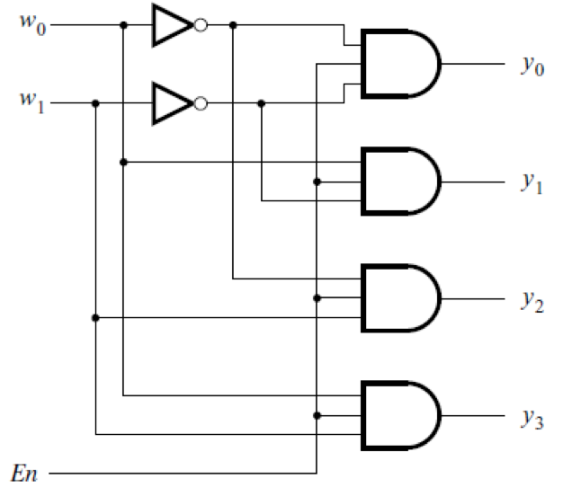
A 1-to-4 demultiplexer
built with a 2-to-4 decoder
[ Figure 4.14c from the textbook ]

Slide 24
A 1-to-4 demultiplexer
built with a 2-to-4 decoder
output
select
lines
the
four
output
lines
data
input
line
D
[ Figure 4.14c from the textbook ]

Slide 25
Multiplexers
(Implemented with Decoders)

Slide 26
A 4-to-1 multiplexer
built using a 2-to-4 decoder
w
0
w
1
s
0
w
y
0
0
s
1
w
y
f
1
1
y
w
2
2
1
En
y
3
w
3
[ Figure 4.17 from the textbook ]

Slide 27
Encoders

Slide 28
Binary Encoders

Slide 29
A 2^{n}-to-n binary encoder
w
0
y
0
2
n
n
inputs
outputs
y
n
–
1
w
2
n
–
1
[ Figure 4.18 from the textbook ]

Slide 30
A 4-to-2 binary encoder
w
w
w
w
y
y
3
2
1
0
1
0
0
0
0
1
0
0
0
0
1
0
0
1
0
1
0
0
1
0
1
0
0
0
1
1
(a) Truth table
w
0
w
1
y
0
w
2
w
y
1
3
(b) Circuit
[ Figure 4.19 from the textbook ]

Slide 31
A 4-to-2 binary encoder
w
w
w
w
y
y
3
2
1
0
1
0
0
0
0
1
0
0
0
0
1
0
0
1
0
1
0
0
1
0
1
0
0
0
1
1
(a) Truth table
?
w
0
w
1
y
0
w
2
w
y
1
3
(b) Circuit
[ Figure 4.19 from the textbook ]

Slide 32
A 4-to-2 binary encoder
w
w
w
w
y
y
3
2
1
0
1
0
0
0
0
1
0
0
0
0
1
0
0
1
0
1
0
0
1
0
1
0
0
0
1
1
(a) Truth table
It is assumed that the
inputs are one hot encoded
w
0
w
1
y
0
w
2
w
y
1
3
(b) Circuit
[ Figure 4.19 from the textbook ]

Slide 33
Priority Encoders

Slide 34
Truth table for a 4-to-2 priority encoder
w
3
w
2
w
1
w
0
y
1
y
0
z
0
0
0
0
d
d
0
0
0
0
1
0
0
1
0
0
1
x
0
1
1
0
1
x
x
1
0
1
1
x
x
x
1
1
1
[ Figure 4.20 from the textbook ]

Slide 35
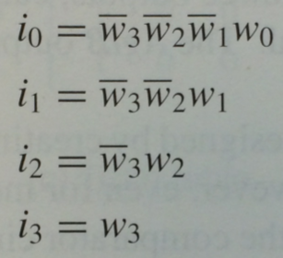
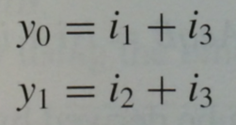

Truth table for a 4-to-2 priority encoder
w
3
w
2
w
1
w
0
y
1
y
0
z
0
0
0
0
d
d
0
0
0
0
1
0
0
1
0
0
1
x
0
1
1
0
1
x
x
1
0
1
1
x
x
x
1
1
1
[ Figure 4.20 from the textbook ]

Slide 36
Code Converter (Definition)
Converts from one type of input encoding to a different type of output encoding.

Slide 37
Code Converter (Definition)
Converts from one type of input encoding to a different type of output encoding.
A decoder does that as well, but its outputs are always one-hot encoded so the output code is really only one type of output code.
A binary encoder does that as well but its inputs are always one-hot encoded so the input code is really only one type of input code.

Slide 38
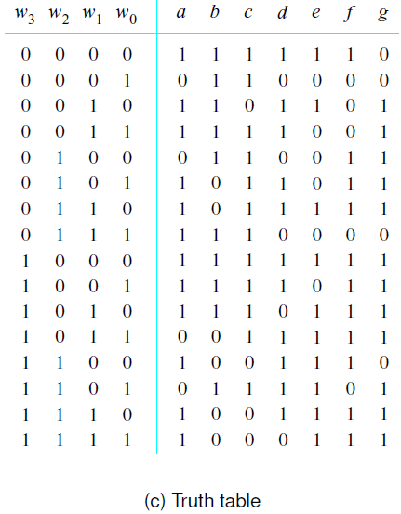
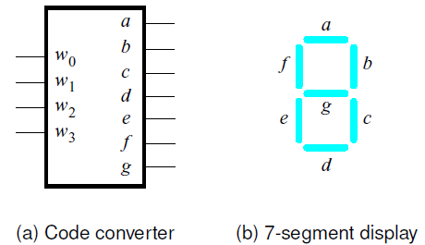
A hex-to-7-segment display code converter
[ Figure 4.21 from the textbook ]

Slide 39
A hex-to-7-segment display code converter
[ Figure 4.21 from the textbook ]

Slide 40
A hex-to-7-segment display code converter
[ Figure 4.21 from the textbook ]

Slide 41
A hex-to-7-segment display code converter
[ Figure 4.21 from the textbook ]

Slide 42
A hex-to-7-segment display code converter
[ Figure 4.21 from the textbook ]

Slide 43
What is the circuit for this code converter?
x₃ x₂ x₁ x₀

Slide 44
What is the circuit for this code converter?
x₃ x₂ x₁ x₀
f(x₁, x₂, x₃, x₄) = Σ m(0, 2, 3, 5, 6, 7, 8, 9, 10, 12, 14, 15)

Slide 45
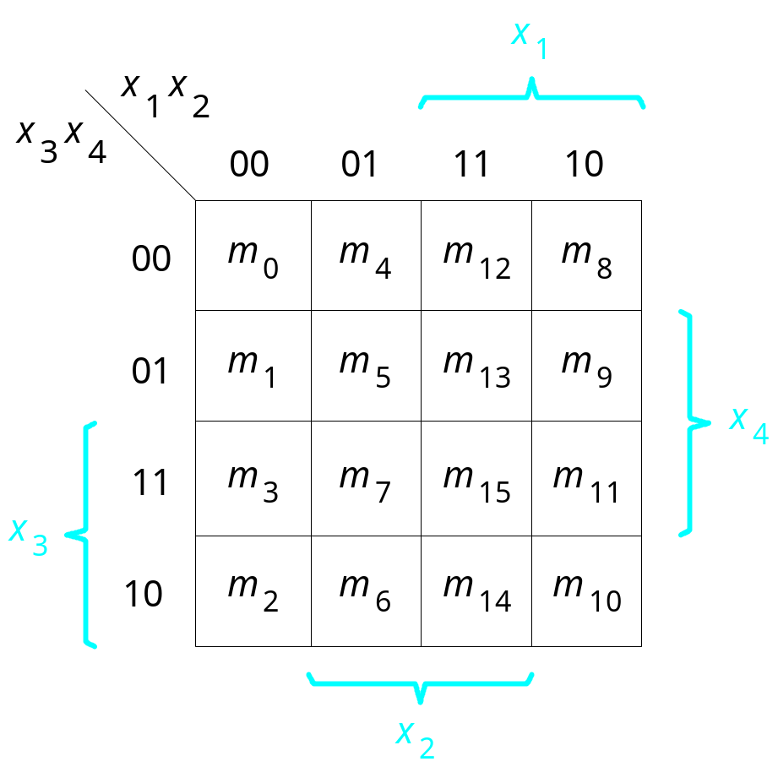
What is the circuit for this code converter?
x₃ x₂ x₁ x₀
1
0
1
1
0
1
0
1
1
1
1
0
1
1
1
1
f(x₁, x₂, x₃, x₄) = Σ m(0, 2, 3, 5, 6, 7, 8, 9, 10, 12, 14, 15)

Slide 46
What is the circuit for this code converter?
x₃ x₂ x₁ x₀

Slide 47
What is the circuit for this code converter?
x₃ x₂ x₁ x₀
1
0
1
1
0
1
1
1
1
0
0
1
1
1
1
0
f(x₁, x₂, x₃, x₄) = Σ m(0, 2, 3, 5, 6, 8, 9, 11, 12, 13, 14)

Slide 48
Arithmetic Comparison Circuits

Slide 49
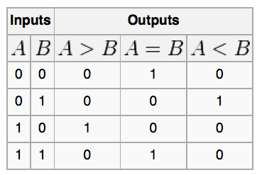
Truth table for a one-bit digital comparator
[http://en.wikipedia.org/wiki/Digital_comparator]

Slide 50
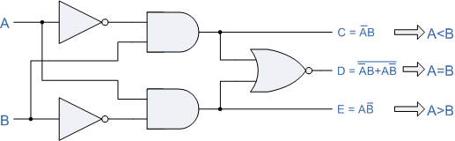
A one-bit digital comparator circuit
[http://www.personal.psu.edu/users///c/w/cwb5096/Old%20Site/index_files/cmpenlab4.htm]

Slide 51
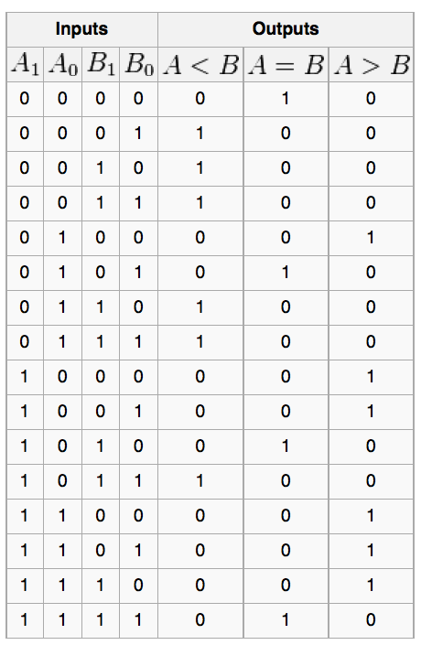
Truth table for a two-bit digital comparator
[http://en.wikipedia.org/wiki/Digital_comparator]

Slide 52
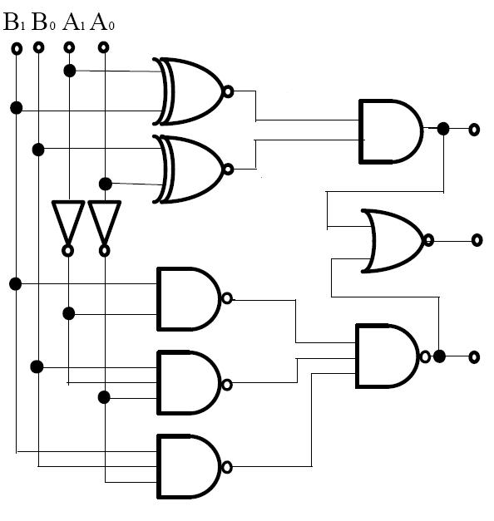
A two-bit digital comparator circuit
[http://forum.allaboutcircuits.com/showthread.php?t=10561]

Slide 53
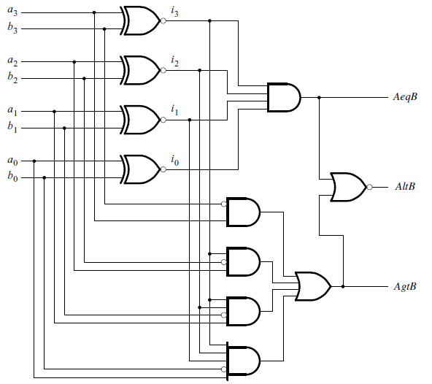
A four-bit comparator circuit
[ Figure 4.22 from the textbook ]

Slide 54
Example Problems from Chapter 4

Slide 55
Example 1: SOP vs Decoders
Implement the function
f(w₁, w₂, w₃) = Σ m(0, 1, 3, 4, 6, 7)
by using a 3-8 binary decoder and one OR gate.

Slide 56
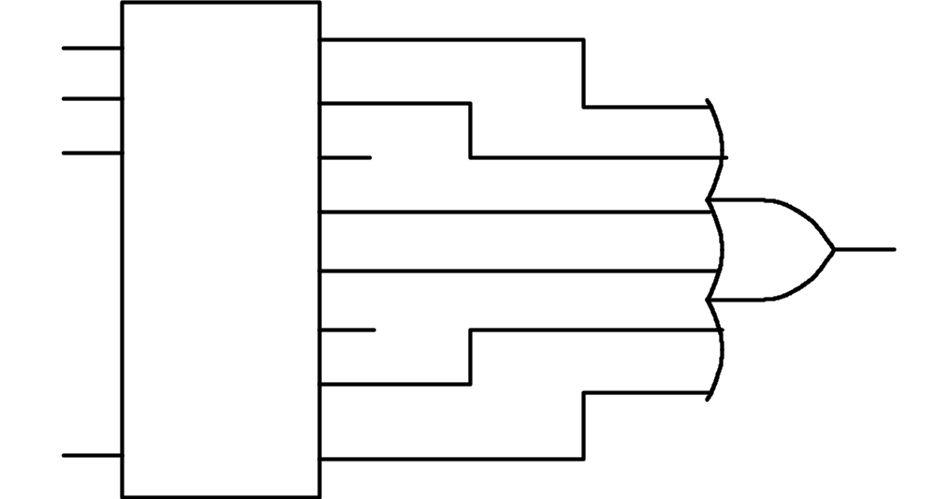
Solution Circuit
w₃
w₀
y₀
w₂
w₁
y₁
w₁
w₂
y₂
y₃
y₄
y₅
y₆
1
En
y₇
f(w₁, w₂, w₃) = Σ m(0, 1, 3, 4, 6, 7)
[ Figure 4.44 from the textbook ]

Slide 57
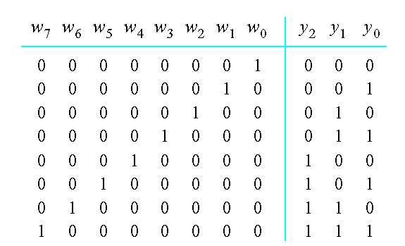
Example 2: Implement an 8-to-3 binary encoder
[ Figure 4.45 from the textbook ]

Slide 58
Example 2: Implement an 8-to-3 binary encoder
y₂ = w₄ +w₅ + w₆ + w₇
y₁ = w₂ + w₃ + w₆+ w₇
y₀ = w₁ + w₃ + w₅ + w₇
[ Figure 4.45 from the textbook ]

Slide 59
Example 3:Circuit implementation using a multiplexer
Implement the function
f(w₁, w₂, w₃, w₄, w₅) = w₁w₂w₄w₅ + w₁w₂ + w₁w₃ + w₁w₄ + w₃w₄w₅
using a 4-to-1 multiplexer

Slide 60
Some Boolean Algebra Leads To
w₁w₂w₄w₅ + w₁w₂ + w₁w₃ + w₁w₄ + w₃w₄w₅
w₁w₄ (w₅ w₂) + w₄ (w₃w₅) + w₁ (w₂ + w₃) + w₁w₄ (1)
w₁w₄ (w₅ w₂) + ( w₁+w₁)w₄ (w₃w₅) + w₁( w₄+w₄) (w₂ + w₃) + w₁w₄ (1)
w₁w₄ (w₅ w₂) + w₁w₄ (w₃w₅) + w₁w₄ (w₂ + w₃) + w₁w₄ ( w₃w₅ + (w₂+w₃) + 1)
w₁w₄ (w₅ w₂) + w₁w₄ (w₃w₅) + w₁w₄ (w₂ + w₃) + w₁w₄ (1)
Note that the split is by w₁ and w₄, not w₁ and w₂

Slide 61
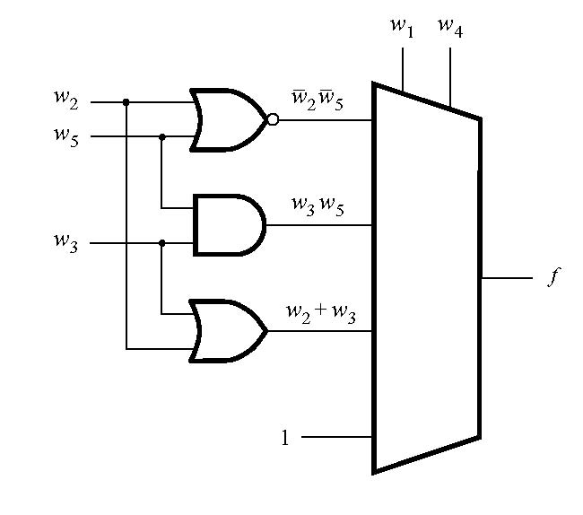

Solution Circuit
[ Figure 4.46 from the textbook ]

Slide 62
Some Final Things from Chapter 4

Slide 63
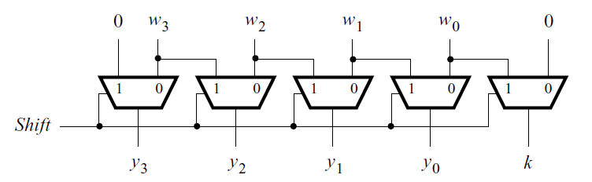
A shifter circuit
[ Figure 4.50 from the textbook ]

Slide 64
A shifter circuit
0

Slide 65
A shifter circuit
0

Slide 66
A shifter circuit
0
w₃
w₂
w₁
w₀
No shift in this case.

Slide 67
A shifter circuit
1

Slide 68
A shifter circuit
1

Slide 69
A shifter circuit
1
0
w₃
w₂
w₁
Shift to the right by 1 bit

Slide 70
A shifter circuit
1
0
w₃
w₂
w₁
w₀
Shift to the right by 1 bit

Slide 71
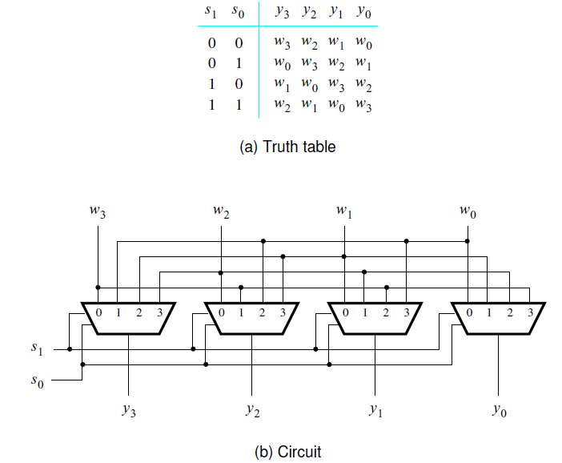
A barrel shifter circuit
[ Figure 4.51 from the textbook ]

Slide 72
Questions?

Slide 73
THE END

